Slide 1
How to run a jar file
CSC 4760 / 6760 Big Data Programming
Spring 2018

Slide 2
How to run a “.jar” file in Linux
In Eclipse, we create a project “HelloWorld”, add “HelloWorld.java” file
Export the “HelloWorld.jar” file, which is a runnable jar file.
Open the terminal, and run the command:
“HelloWorld.java” file
java -jar HelloWorld.jar
package HelloWorld;
public class HelloWorld {
public static void main(String[] args) {
// Prints "Hello, World" to the terminal
System.out.println("Hello, World");
}
}
You will see “Hello World!”

Slide 3
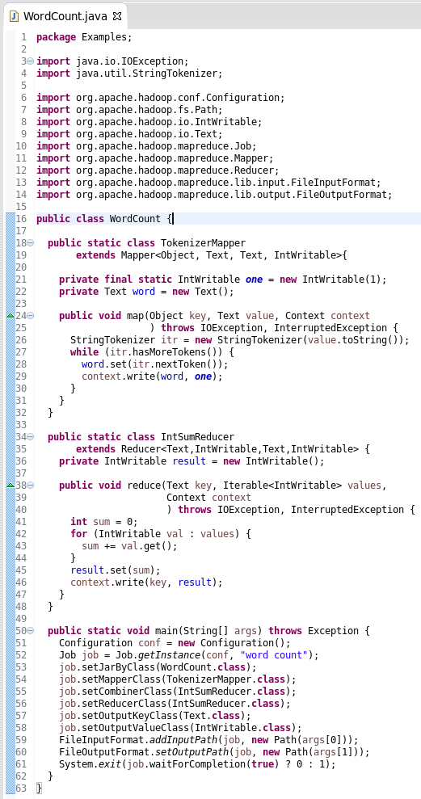
MapReduce Code: WordCount
https://hadoop.apache.org/docs/stable/hadoop-mapreduce-client/hadoop-mapreduce-client-core/MapReduceTutorial.html

Slide 4
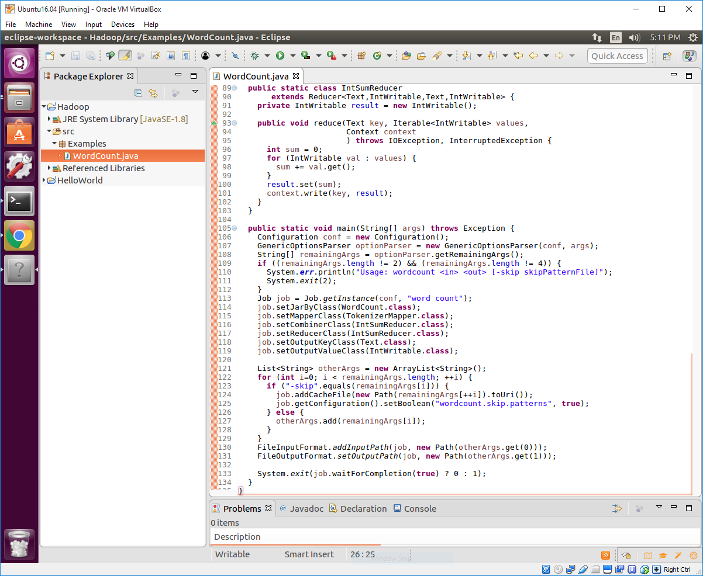
Eclipse Project
Right click on the “Hadoop” project
-> Choose “Properties”
->

Slide 5
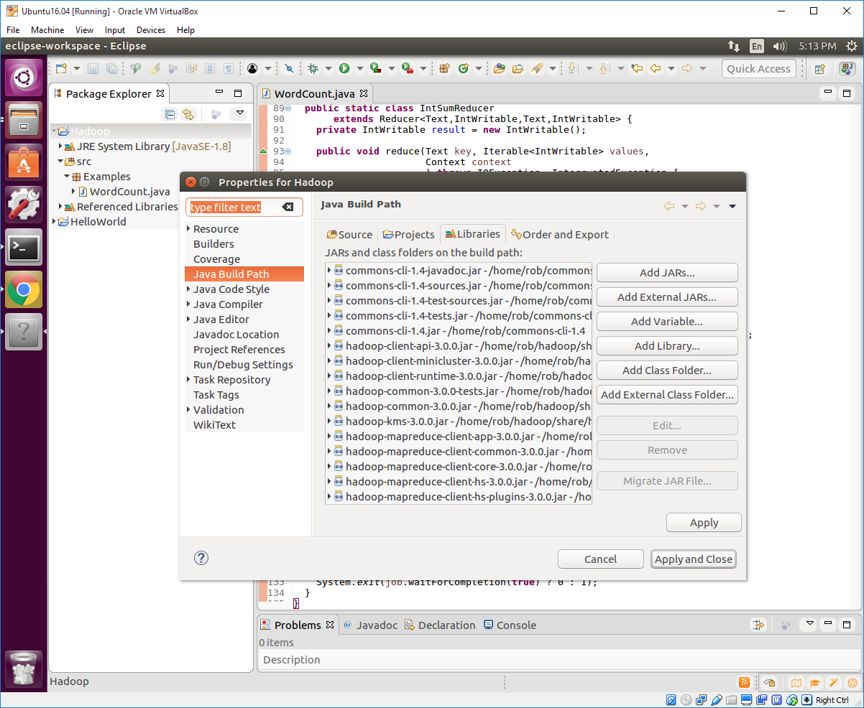
Eclipse Project
Right click on the “Hadoop” project
-> Choose “Properties”
-> “Java Build Path”
-> “Libraries”
-> “Add External JARs …”
Add all the jar files in :
/home/rob/hadoop/share/hadoop/common
/home/rob/hadoop/share/hadoop/mapreduce

Slide 6
Download Apache Commons CLI
In order to use “GenericOptionsParser”, we need to add these jar files.
Apache Commons CLI 1.4
https://commons.apache.org/proper/commons-cli/download_cli.cgi
commons-cli-1.4-bin.tar.gz
unzip the file
Add all the jar files in :
/home/rob/commons-cli-1.4

Slide 7
Eclipse Project
After we add these “.jar” files to the project, there should be no errors.
Menu “Run” -> “Run Configurations” -> “Java Applications” -> New -> Give it a name, choose the project such as “Hadoop”, and set the main class such as “Examples.WordCount” -> Close, Do not Run.
Right click on the project, and choose “export” -> “Java” -> “Runnable JAR File” -> Launch configuration -> Export desitnation -> Finish
You get the “WordCount.jar” file finally.
Open a terminal, and run the command
>> hadoop jar WordCount.jar /user/rob/data/peterpan.txt /user/rob/output1
The output folder must not be created

Slide 8
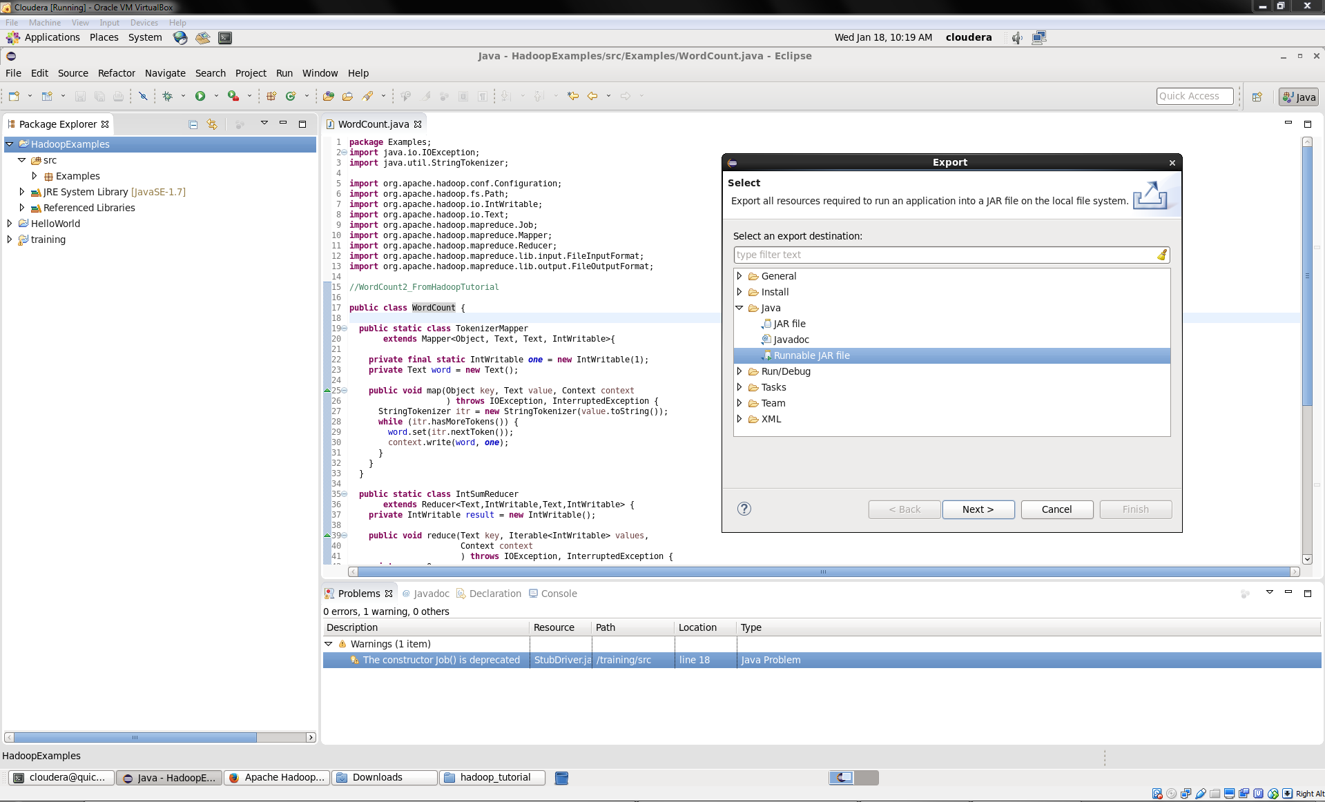
Export a JAR file
Runnable JAR file

Slide 9
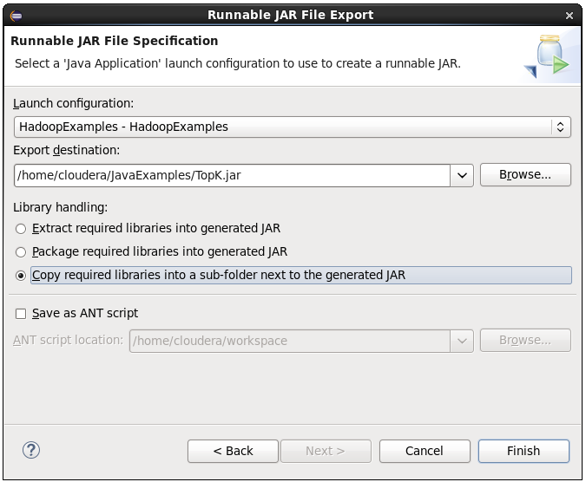
Choose the “Run Configuration”
Choose your “run configuration”
Select on option for “library handling”

Slide 10
Run a JAR file
Assuming that:
/user/joe/wordcount/input - input directory in HDFS
/user/joe/wordcount/output - output directory in HDFS
Commands:
If you have specified the main class
hadoop jar WordCount.jar /user/joe/wordcount/input /user/joe/wordcount/output
If you did not specify the main class
hadoop jar WordCount.jar WordCount /user/joe/wordcount/input /user/joe/wordcount/output

Slide 11
If you donot specify the “Main Class” in “Run Configuration”, you need to specify it in the “hadoop” command
Command to run a “.jar” file
Name of main class “WordCount”
hadoop jar WordCount.jar /user/rob/data/peterpan.txt /user/rob/output
Runnable JAR file
Input file
Output Directory
Try:
hadoop jar WordCount.jar WordCount /user/rob/data/peterpan.txt /user/rob/output
Try:
hadoop jar WordCount.jar WordCount.WordCount /user/rob/data/peterpan.txt /user/rob/output

Slide 12
Trick in Running Hadoop command
Good Command:
hadoop jar WordCount.jar /user/rob/data/peterpan.txt /user/rob/output
Good Command:
hadoop jar WordCount.jar /user/rob/data/ /user/rob/output
Read and process all the files in the directory “/user/rob/data/”
Bad Command:
hadoop jar WordCount.jar /user/rob/data/ /user/rob/data/output
Hadoop will create a folder “/user/rob/data/output”. It is not a file. It is a folder.
You will get an error.

Slide 13
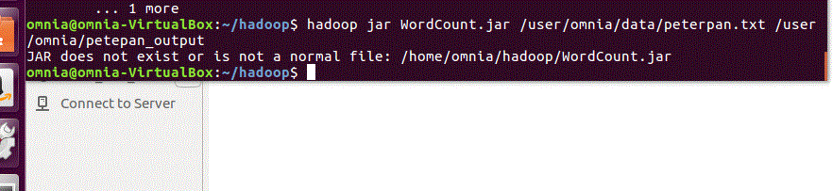
Example of Bad Commands
Need to specify the exact directory of WordCount.jar
hadoop jar /home/omnia/Test/WordCount.jar /user/omnia/data/ /user/omnia/data/output

